Slide 1

Swen Assignment 3
Delonix Regia Hotel Management System
Team members:
Sin Jun Jie
Nigel Yee Wei Peng
Muhd Riduwan Bin Zainudin
Muhammad Zulafandi Bin Yazab
Tutor: Mr Mel Goh
Class: P03

Slide 2
Introduction
Proposed Hotel Management Features and Modules:
Guests and Booking Module (Nigel)
Housekeeping and Staff Management Module (Riduwan)
User management and login creation Module (Junjie)
Restaurant booking module (Zulafandi)

Slide 3
Guests & Booking Module - Nigel Yee
Overview of Guest & Booking Module:
Allows staff to retrieve existing guest details
Allows staff to create a new guest id and input the new details
Allows staff to update existing guest details
Allows staff to create booking for guest using guest id
Show the available rooms in a user friendly interface
The guest id and detail will be used to create the booking for the guest.

Slide 4
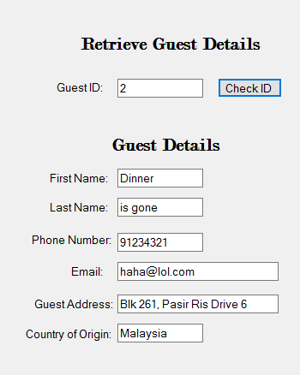

Retrieving existing Guest details
Input an existing guest id (Typically, the guest will know their id).
Click on “Check ID”
Guest details are retrieved from database.

Slide 5
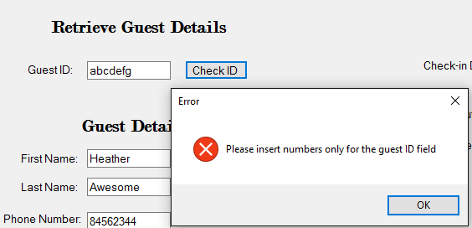
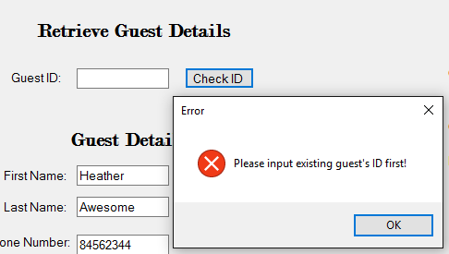
Managing Exceptions while retrieving invalid data
GuestID only accepts integers, entering a string or other data type would cause the the program to throw an exception.
Same goes for an empty input, it would cause an exception if there is no input value.

Slide 6
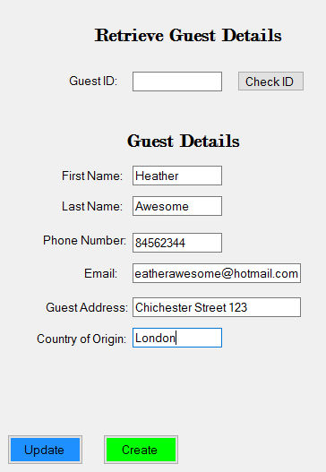
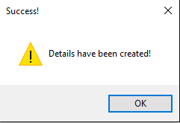
Creating new guest entry
Guest ID should be left blank when creating new guest
Enter guest’s information in the text boxes, and click ‘Create’
Pop up box shows that Details are created.

Slide 7
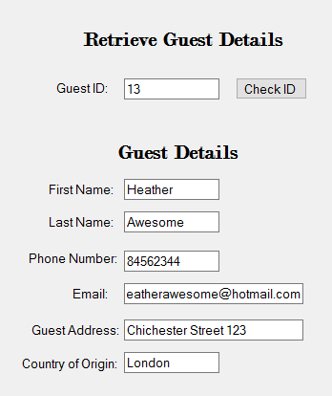

Creating new guest entry
Guest ID will be auto-generated after successful guest detail creation
The newly created guest details are reflected in the database.

Slide 8
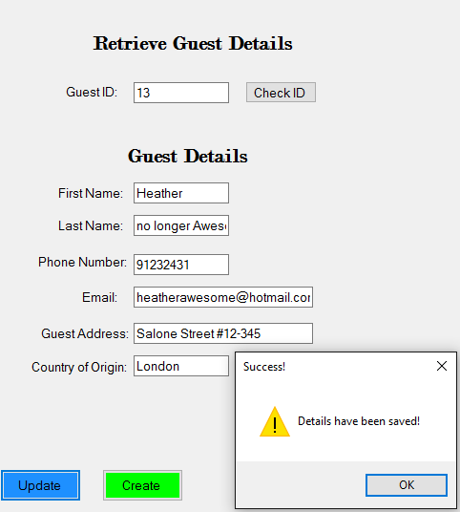
Updating existing guest details
Enter and retrieve existing guest id
Edit the relevant information to be changed
Click on “Update” to update details
Details will be updated and reflected on database

Slide 9
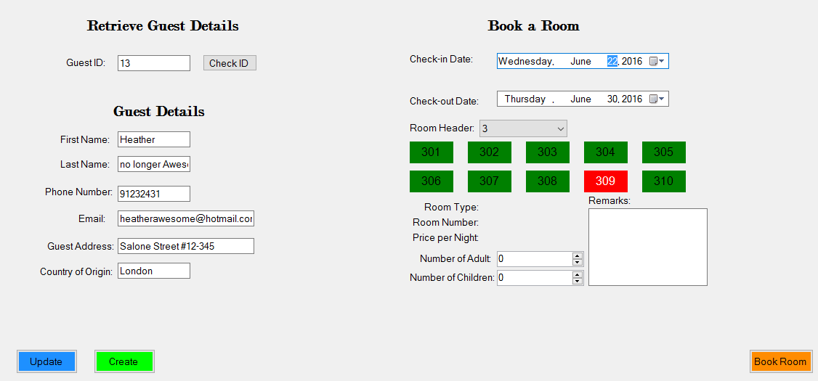
Creating new Booking for guest
Booking will be assigned based on selected guestid as seen on the left side of the form.
Select the period of stay from the date selection calendar.

Slide 10
Creating new Booking for guest
Select the room type from the Room header dropdown list.
Green boxes means the room is vacant while Red means it is occupied.

Slide 11
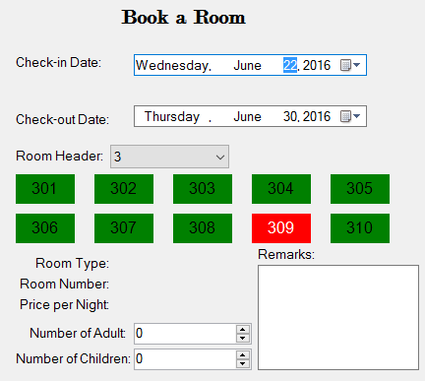
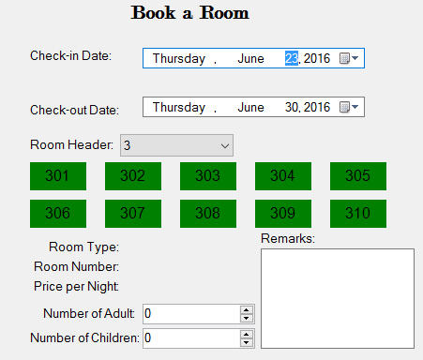
Selection of new room booking for guest
The room availability status updates dynamically. E.g. if a room has already been booked for a specified period of time, it will be displayed as ‘occupied’ to disallow booking of the occupied room for that period of time and vice versa.

Slide 12
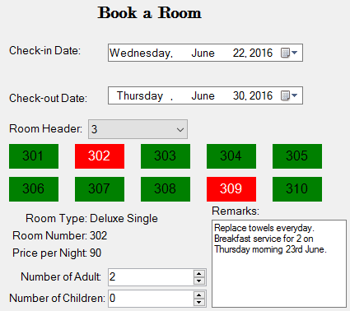
Confirm booking of room
After selecting a desired room and number of occupants, the summary would be displayed, such as Room type, room number and the price. Additional remarks may be added as well.

Slide 13
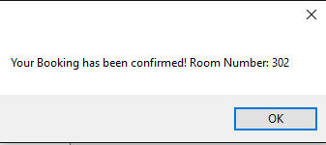
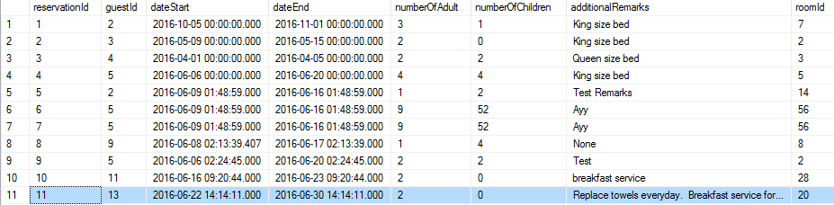
Confirm booking of room
Once confirmed, click on ‘Book Room’ to secure the room.
Reservation would be reflected on the database and identified by the guest ID.

Slide 14
Housekeeping and Staff Management Module-Riduwan
Allows new staff to be created inside the database
Allows the retrieving information of staff
Allows updating of staff information
Allows deleting of staff records inside the database

Slide 15
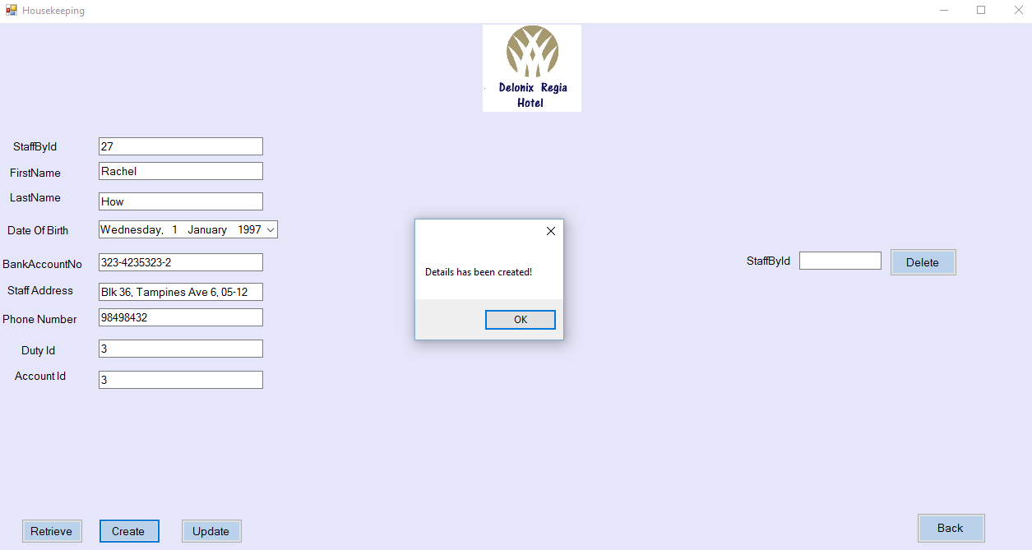

Create Staff Allow new HouseKeeping Staff to be created inside the database.

Slide 16
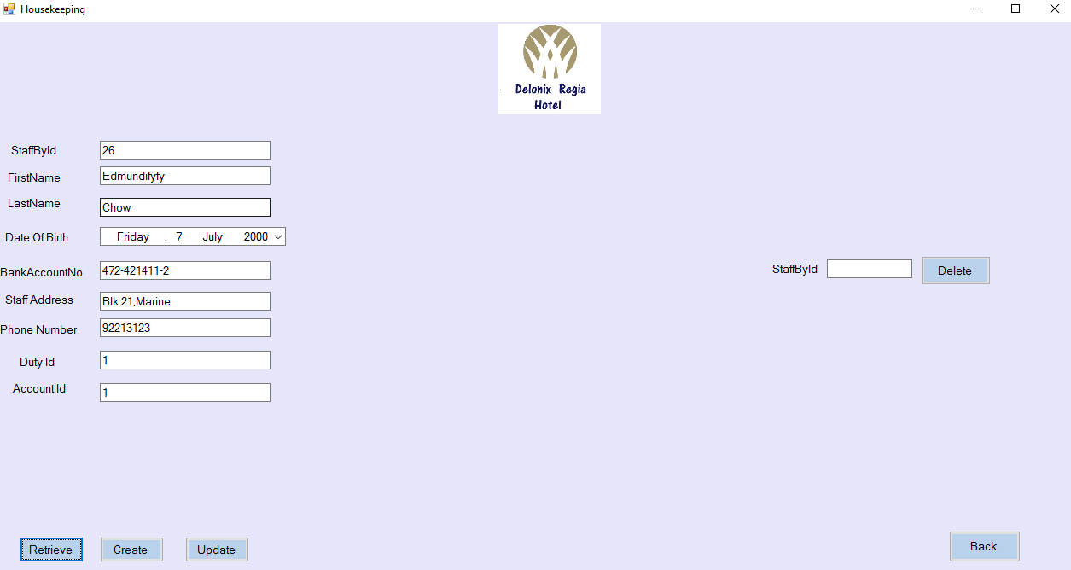
Retrieve Staff
Information
By entering the StaffId, the system is able to retrieve staff information and records from the database

Slide 17
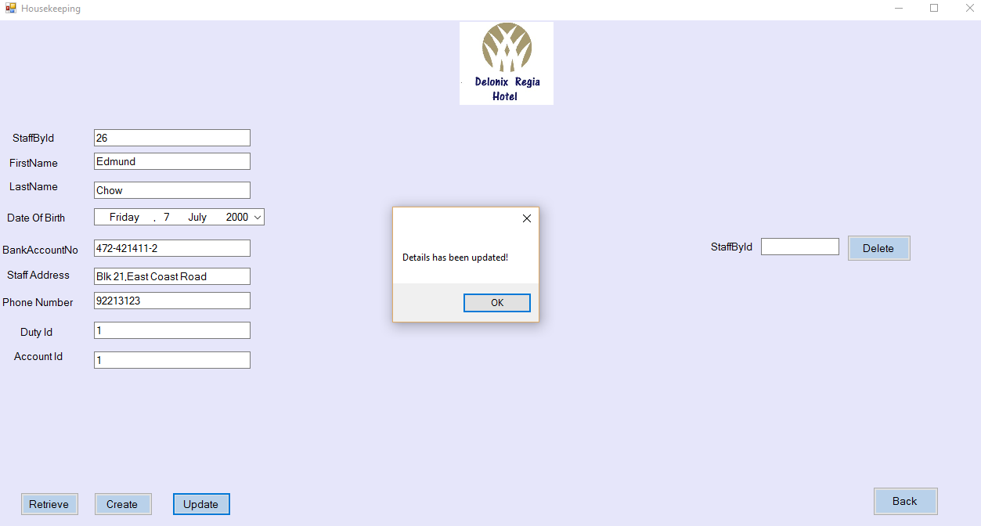
Update Staff
Information
Allows the staff information to be updated, for example I have edited the first name of the staff and the staff address. This updates the database.

Slide 18
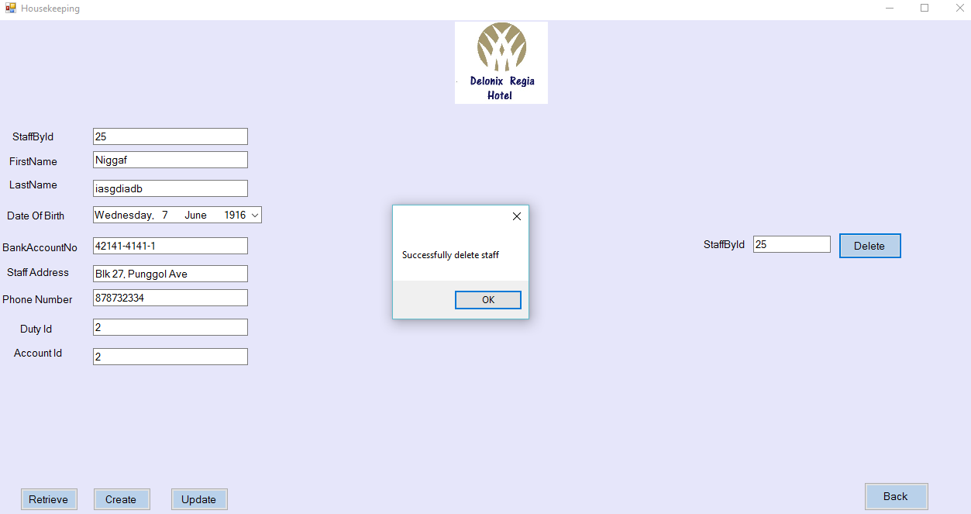
Delete Staff Records
By entering the staff id, for example staff id number 25, this will delete the staff records stored in the database.

Slide 19
User management and login module - Jun Jie
Allows the administrator (Mr Wang) to login to access the user management and login module
Allow administrator to create staff accounts
Allow administrator to retrieve staff account details by account Id
Allow administrator to update staff account details
Allow administrator to delete staff account by account Id

Slide 20
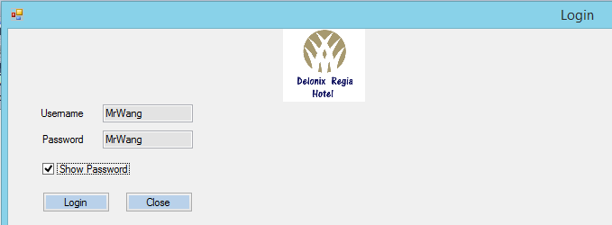
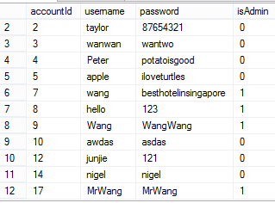
Login
Allows users such as the administrator to login
As long as the user enters the correct username and password that is in the database, the login would be successful

Slide 21
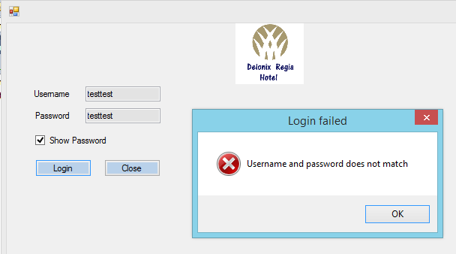
Error handling in login
When the users wrong username and password, for example a account that is not existing. A error message in the form of a message box would be shown “Username and Password does not match

Slide 22
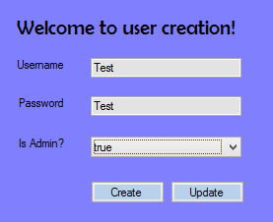
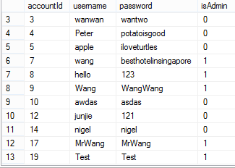
Create Account
Allow the administrator to create employees/administrator account
A user account with the username “Test” and password “Test” is created, This is reflected in the database as well. User with the login details could log in with the username and password

Slide 23
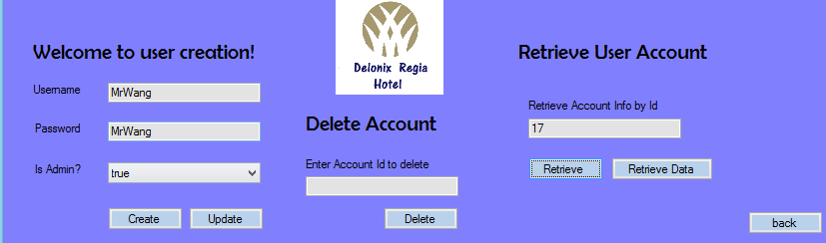
Retrieve Account Information
This function allows us to retrieve account information of a particular person by entering the Account Id. For example, i want to retrieve information of a user by the account id of 17, it will return username “MrWang” and password “MrWang”.

Slide 24
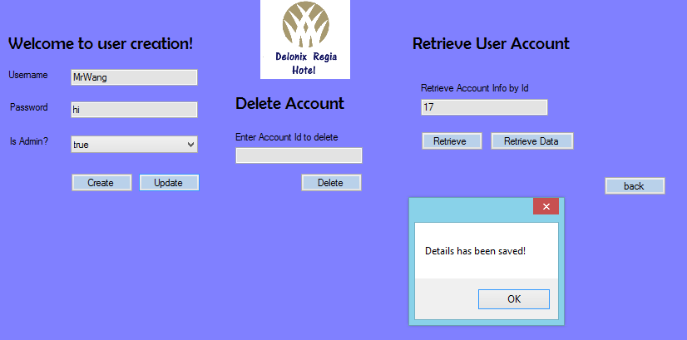


Update Account information
This function allow users to update the username and password of the account by Account Id.
Upon Clicking update, the password “MrWang” with the Account Id 17 will be changed to “hi”.

Slide 25
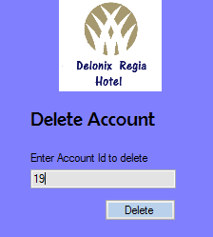
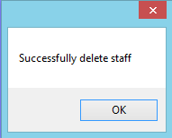
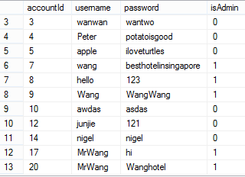
Delete User Account
As can be seen, the account with account Id 19 is deleted from the database
This function allows the administrator to delete a account

Slide 26
Restaurant Booking Module - Zulafandi
Allows new user to be created inside the database
Allows the retrieving information of booking
Allows updating of booking information

Slide 27
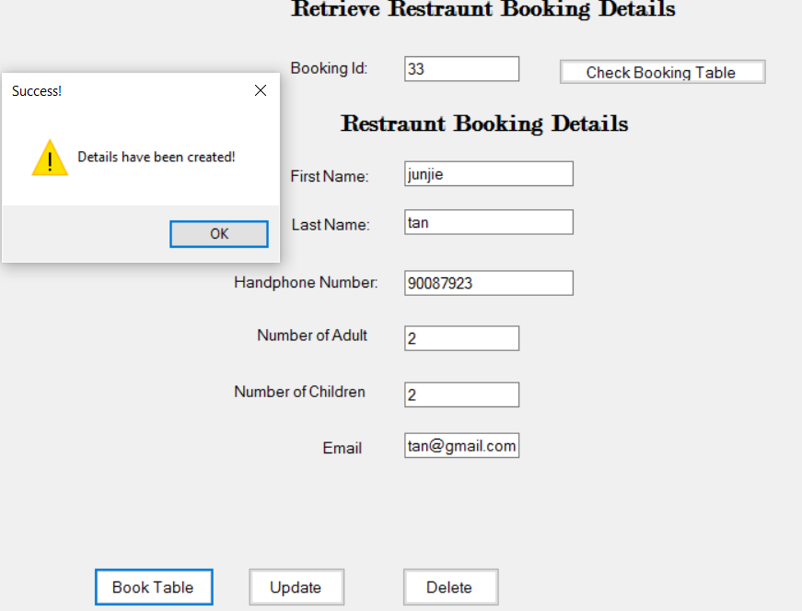
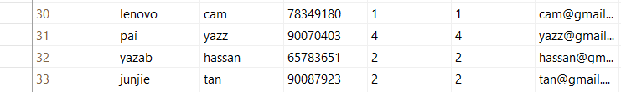
Create Booking (Zul)
Allow new user to Booking table in the database.

Slide 28
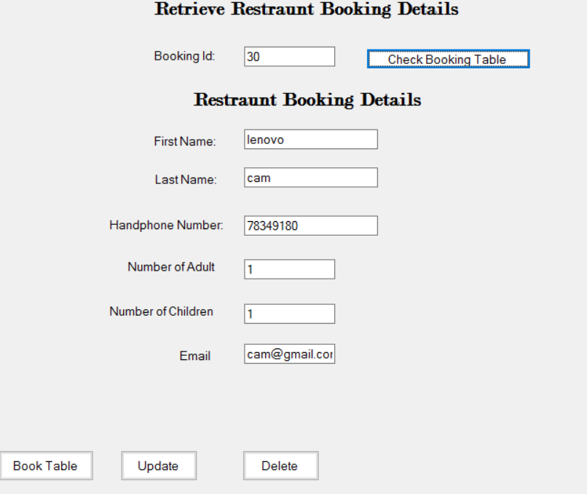
Retrieve booking
Information
(zul)
By entering the Booking Id, the database system is able to retrieve user information from the database

Slide 29
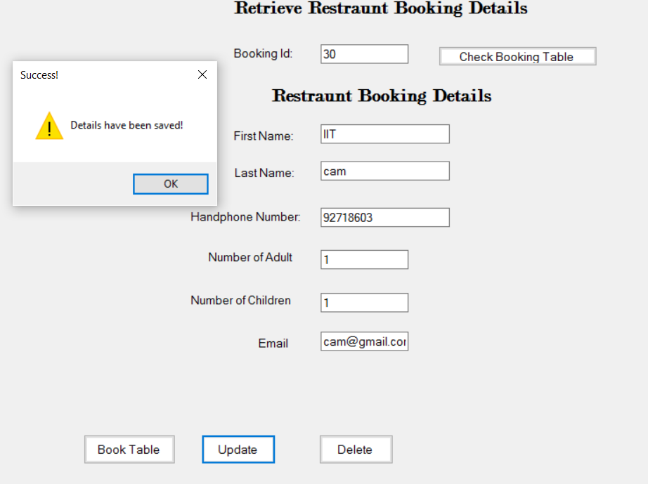
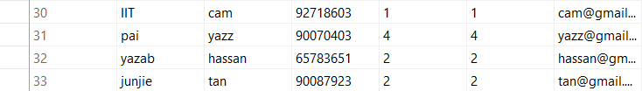
Update Booking
Information
(zul)
Allows the user information to be updated, for example I edit the first name and the contact number. This updates the database
(Before update)
(After update)

